Slide 1
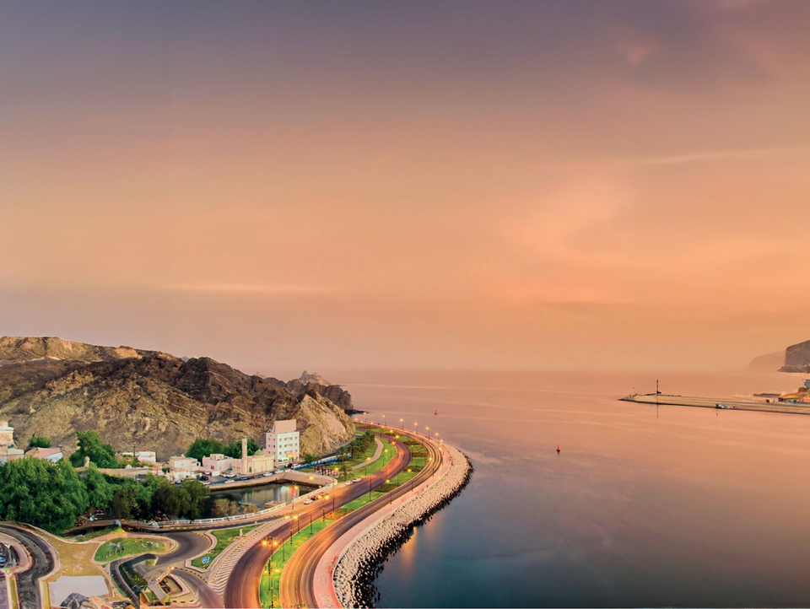


DHOFAR UNIVERSITY
COLLEGE OF ENGINEERING
Poster Competition
“REWAA DHOFAR:
Sustainable Development in Oman”
Sustainability in the Sultanate of Oman
www.du.edu.om
EWAA
WHERE GROWTH FINDS ITS ROOTS
Write your title here
Author (1), Author (2), Author (3) –
Example: M. KHALDI (1), G. LEE (2), S. PAULSEN (3)
1. Position ……, Center/Faculty of ……, University of……, Country => email adress
2. Position ……, Center/Faculty of ……, University of……, Country => email adress
HIGHLIGHTS & GRAPHICAL ABSTRACT
OBJECTIVES
RESULTS
(3 to 5 points)
Objective: Clearly define the purpose of your poster, outlining the primary goals and the significance of your research or project.
Methodology: Briefly describe the methods or approaches used in your work, emphasizing any innovative techniques or unique perspectives.
Findings/Results: Summarize the main outcomes or discoveries, highlighting their impact and relevance to the field.
Incorporating a graph or chart can enhance the visual appeal and effectiveness of your poster. For instance, a bar chart can effectively display comparative data, while a pie chart can illustrate proportional relationships. Ensure that any visual aids are clear, well-labeled, and directly support the content of your highlights.
his section should clearly articulate the primary objectives of your project or research. Focus on outlining the goals you aim to achieve and how they address the identified problem. Emphasize the alignment of your objectives with sustainable development principles, Oman Vision 2040, and the broader socio-economic and environmental context.
  Tip:
Use concise and action-oriented statements to define what your solution seeks to accomplish, such as enhancing resource efficiency, promoting innovation, or driving community impact.
  Example:
The objective of this project is to develop a cost-effective, solar-powered desalination system to sustainably meet Dhofar’s growing water demands while reducing reliance on groundwater resources.
This section presents the outcomes of your research or project, directly addressing the hypothesis or question stated in the introduction. Summarize key findings concisely, focusing on their significance and alignment with your objectives.
Content:
  Highlight the most important results using bullet points for clarity.
  Include graphs, tables, or visuals to support and illustrate your findings.
  Provide an impact assessment, detailing potential benefits to the community, environment, and economy.
Tip: Emphasize how your results align with Oman’s Vision 2040 and the United Nations Sustainable Development Goals (SDGs) to reinforce the relevance and broader implications of your work.
Example:
  The solution reduced water consumption by 30% in pilot tests.
  Energy efficiency improved by 20% with solar-powered technology.
  Alignment with SDG 6 (Clean Water) and SDG 13 (Climate Action).
SUSTAINABILITY & BUILT ENVIRONMENT
METHODOLOGY
CONCLUSION
Keywords: (5 to 8 Keywords)
This section outlines the approach and methods used in your research or project. Provide a detailed explanation of your innovative solution, including its scientific or engineering basis. Highlight the strategies your team employed, the methodologies applied, and any special technologies utilized.
Content:
  Describe the step-by-step process for implementing the solution.
  Explain the sustainability aspects, addressing environmental, economic, and social benefits.
  Discuss scalability, feasibility, and cost-effectiveness to demonstrate the solution’s practicality and broader applicability.
Example:
Our approach integrates solar-powered desalination with IoT-based monitoring systems, ensuring energy efficiency and real-time resource management.
This section should summarize the key findings and takeaways from your research or project. Highlight two to three actionable results that are most significant and relevant to addressing the identified challenge. Provide a brief explanation of these findings to encourage dialogue or further discussion with the audience.
Content:
  Summarize the main outcomes and their potential impact.
  Propose actionable items that could lead to implementation, policy creation, or further study.
  End with a compelling call to action, emphasizing the importance of adopting sustainable practices in Oman and the Gulf region.
Example:
The integration of solar-powered desalination technology has proven to be a cost-effective and scalable solution for Dhofar’s water challenges. Policymakers and stakeholders are encouraged to prioritize similar innovations to advance Oman’s Vision 2040 and the UN Sustainable Development Goals.
PROBLEM STATEMENT
(75–100 words)
  This section should clearly define the specific challenge your project aims to address, such as water scarcity, renewable energy, waste management, urban planning, or biodiversity conservation. Provide a detailed description of the issue, emphasizing its significance to Oman and Dhofar by linking it to the region’s socio-economic, environmental, and cultural context.
  Tip:
Use concrete data, real-world examples, or compelling statistics to highlight the urgency of the problem and engage your audience.
  Example:
Dhofar’s water resources face increasing strain due to rising demand and shifting climate patterns, threatening its economy and environment.
REFERENCES
Include only the most relevant and essential references that directly support your research or project. Focus on key sources, such as foundational studies, government reports, or significant academic publications. Ensure the references are concise and properly formatted to conserve space on your poster.
EWAA
www.du.edu.om

